Slide 1
Fingerspelling Keyboard Layouts for Khmer SignWriting
Co.SuperVisor: Dr. Ye Kyaw Thu
SuperVisor: Dr. Kong Phutphalla
Student: OENG MENGTHONG

Slide 2
Outline Content
Problem and Objective
Literature Review
Timeline
Update Progress

Slide 3
Problem and Objective
Now aday technology was involed for living , education, work and more. Normal people can access easily, but for deaf people they still have limited access to internet and technology. Because they have low skill with khmer & english language.
Their nature language is Fingerspelling, so I want to build keyboard signwriting for khmer fingerspelling using global font Sutton SignWriting.

Slide 4
Literature Review
Direct Keyboard Mapping (DKM) Layout for Myanmar Fingerspelling Text Input (Study with Developed Fingerspelling Font “mmFingerspelling.ttf)
author: Ye Kyaw Thu†, Sai Aung Win Maung‡ and Yoshiyori Urano†
Two Fingerspelling Keyboard Layouts for Myanmar SignWriting
author: Hlaing Myat Nwe†, Ye Kyaw Thuλ γ , Hnin Wai Wai Hlaing†, Swe Zin Moe†,Ni Htwe Aung‡, Hnin Aye Thant†, Nandar Win Min†
Myanmar SignWriting Keyboard MappingLayout for Fingerspelling
author: Hlaing Myat Nwe† , Ye Kyaw Thuλ and Hnin Aye Thant†

Slide 5
Timeline
Task | Nov | Dec | Jan | Feb | Mar | Apr
Learn Khmer Fingerspelling
Learn Suttun SignWriting
Collected Sign Fingerspelling
Implement 3 layouts keyboard concept (linux OS)
User study
Implement on Windows and Mac
Write paper publish to journal

Slide 6
Update Progress
Finish
Next Task
Understand what signwriting
Understand Khmer Fingerspelling
Collected all Khmer Sign Fingerspelling from NISE
Finish Keyboard Mapping Khmer SignWriting using current concept keyboard layout NIDA
Make 2 more Keyboard Mapping Khmer SignWriting with new concept keyboard layout
User Study on 3 concept Keyboard layout
Implement on Windows and Mac
Write Paper publish to journal

Slide 7
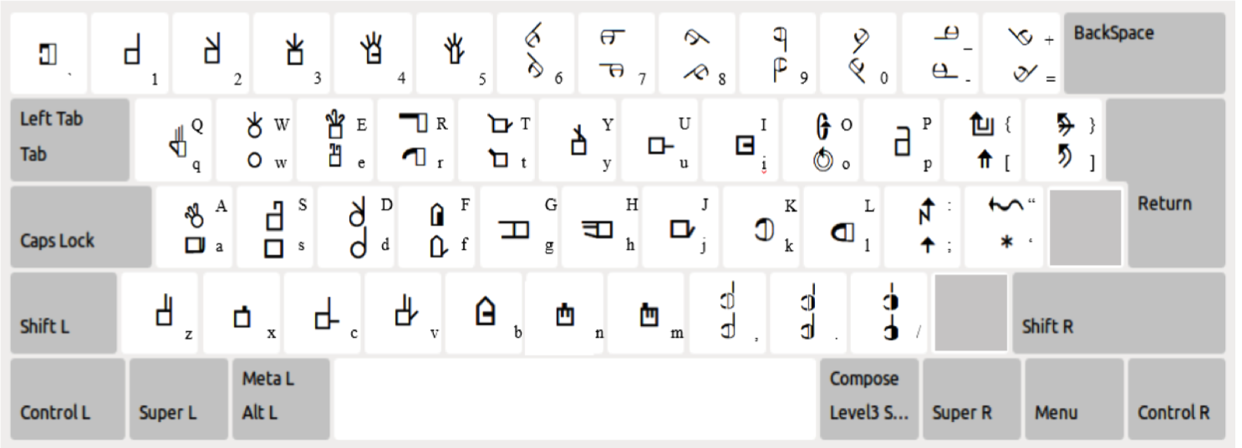
Thank you
OENG MENGTHONG

